Slide 1


LIMSABC Quick User Guide

Slide 2
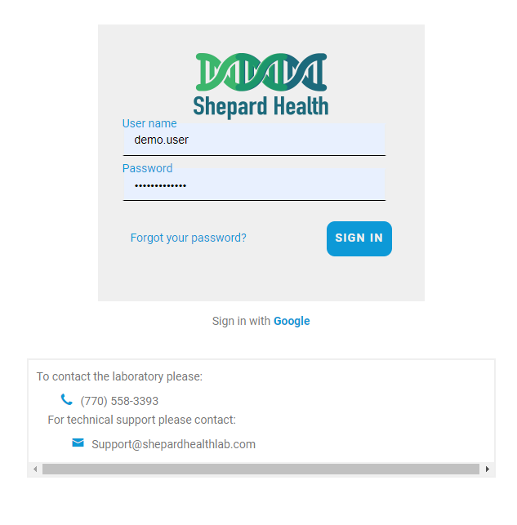

Logging into the new Shepard Health Client Portal
Shepard Health now uses LIMSABC as our ordering, reporting, and laboratory information system.
This system is browser based for ease of access
Allows for easy ordering and requisition creation
Better Patient Management
Readily available reports
Automatic notifications with critical results
To log in please head to our portal website. We recommend chrome or edge for the best user experience.
https://shepardhealth.limsabc.com
Once you see the login screen, please input your user credentials.
If logging in for the first time, it will prompt to change your password. Please change it within 72 hours of activation of your user account.
If having any issues, please call the lab during normal laboratory hours for immediate assistance, or if after hours please send an email.
Shepard Health Staff will contact you as soon as possible.

Slide 3
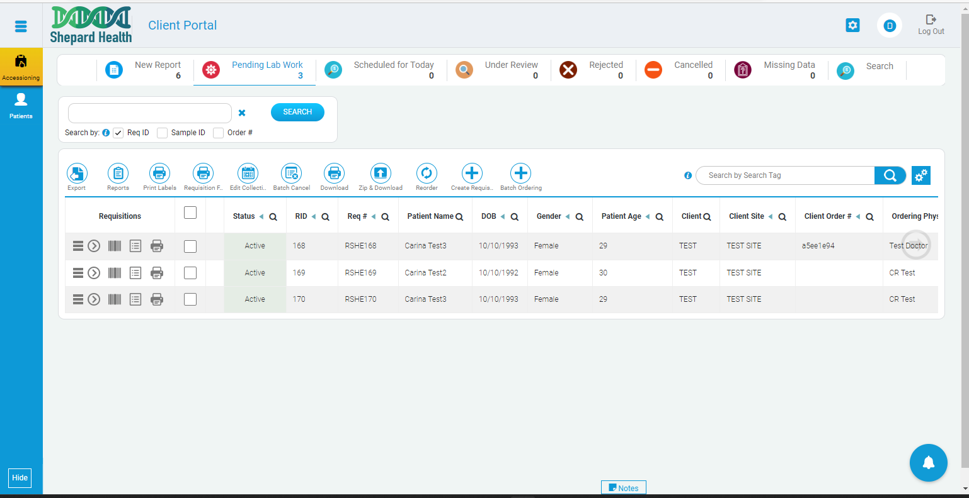
This is the home screen for our Client Portal. The default view will be the Accessioning tab with the Pending Lab Work filter.
The currently viewed tab will be highlighted in yellow.
The currently selected filter will be highlighted or underlined in blue
There are 2 available screens
Accessioning (Default)
Patients
There are 8 filters available in the Accessioning screen.
New Reports
Pending Lab Work (Default)
Scheduled for Today
Under Review
Rejected
Canceled
Missing Data
Search

Slide 4
Pending Lab Work
From the pending lab work screen, you can quickly
Create new orders/requisitions
View existing orders in process
Print out requisitions and sample labels
Create, edit, and cancel batch orders
Edit Collection date and time of existing orders
Export requisition data
Search for specific created orders

Slide 5
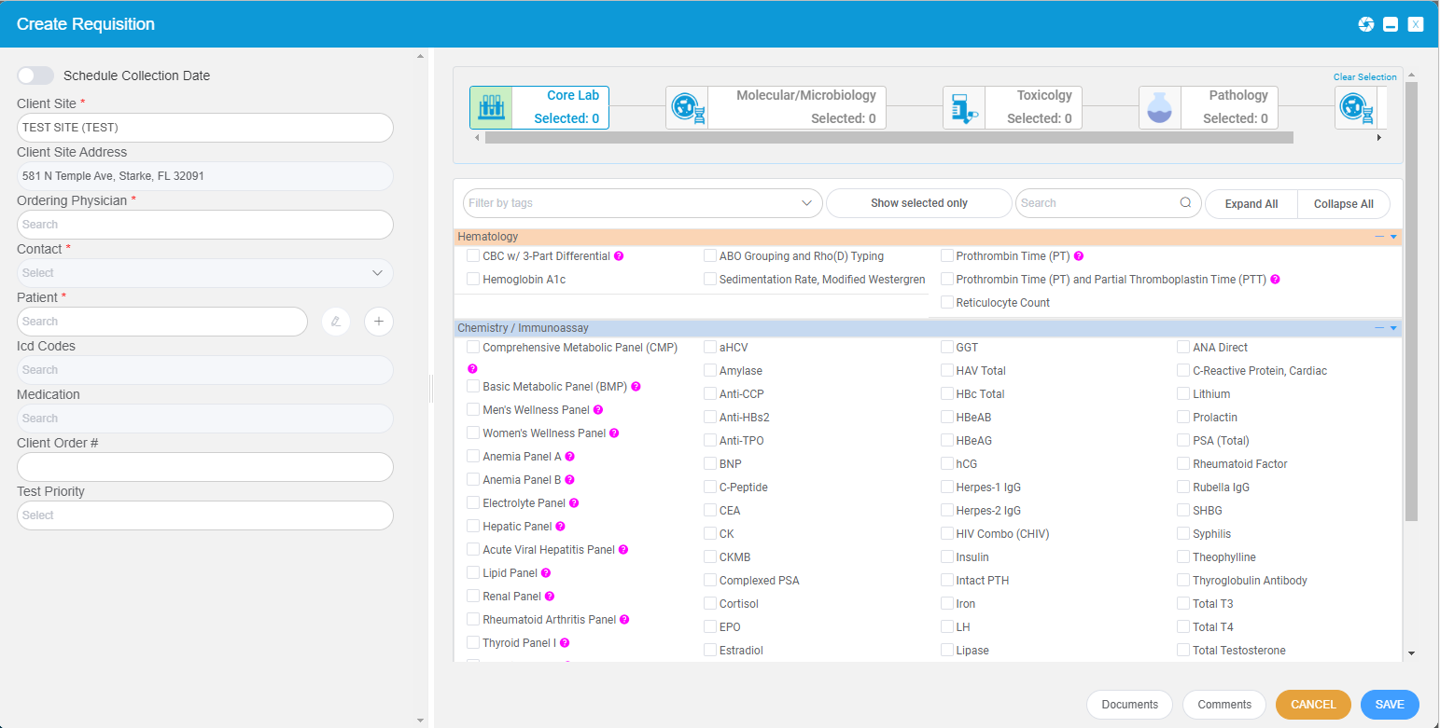
Creating an order/requisition
From the pending lab work screen, you can create a lab work order by clicking on the create requisition button.
After clicking on the button, a Create Requisition screen will pop up with all tests offered by Shepard Health. All your site information will be preloaded into the system for easy ordering.
Patient information and Site ordering information is located on the left side of you screen.
All orders will require;
A Contact
A Client Site (will have to be selected if the account has multiple locations)
The Ordering Physician/Provider
Patient information
ICD-10 Codes

Slide 6
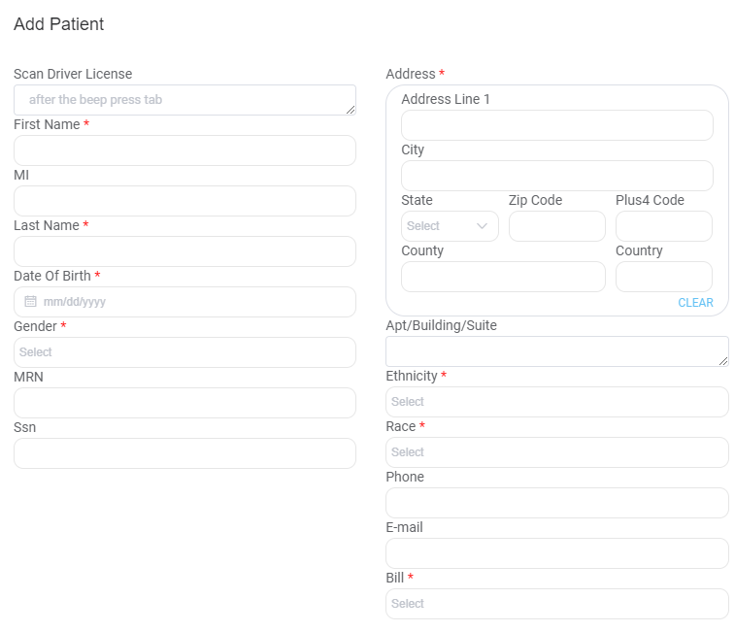
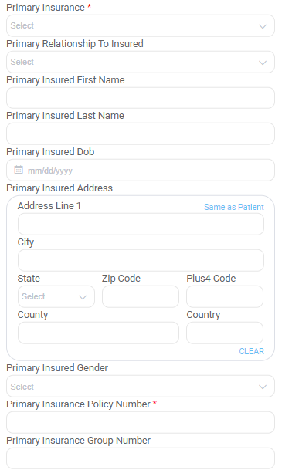

Adding patient Demographics
On the create requisition screen, right next to the patient search bar are two icons the “+” and the pencil. The pencil icon allows for editing of existing patient information, like updating insurance info.
The “+” icon will allow the inputting for new patient info.
If there is a scanner available. Some information can be added using the patient’s drivers license or ID
Once inputted press save. The patient info will be saved and associated with the ordering Client Site.

Slide 7
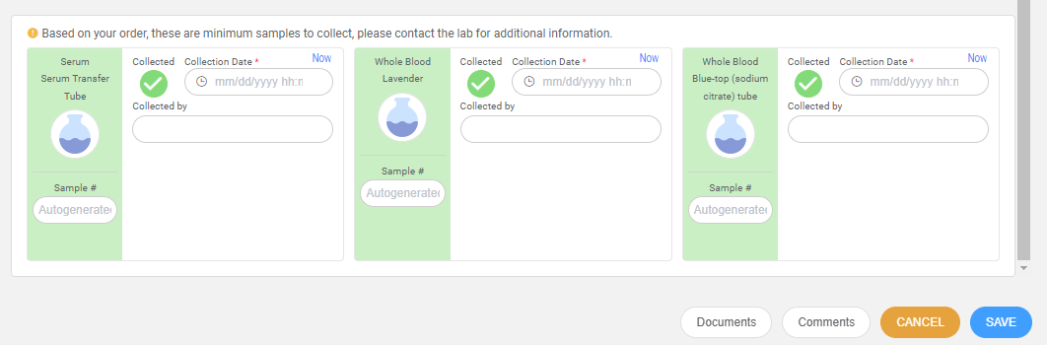
From the requisition popup there are various fields that can be inputted and selected.
The default view is Core Lab testing. The currently selected tab will be highlighted in green. All tests are organized into different areas of the lab or required specimen types
To allow for easy ordering. You can check the boxes to select the desired tests.
Hovering over the pink “?” will show what test are included with each panel or special instructions required for the test.
Once tests are selected, you can scroll down, and the system will automatically recommend the collection devices.
Once all data has been entered and tests ordered, simply press the “save” button to finish the requisition creation.
It will then take you to the print requisition screen.

Slide 8
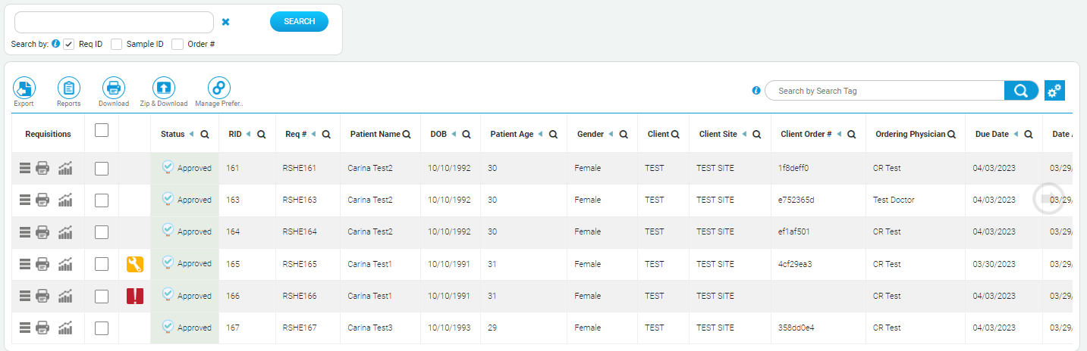
Viewing Results and Reports
Back on the accessioning screen. Click on the New Report filter.
View Report
STAT
Critical
Once the new report tab is selected, the most recent results will be displayed. From here you can;
View the report by clicking on the printer icon.
Download reports by selecting the test(s) and pressing the download button.
View important flags associated with the result. (Critical, Stat, or has Comments)
When a report has been reviewed, it will move from the New Report filter into historical data, which can be easily found using the Search filter

Slide 9
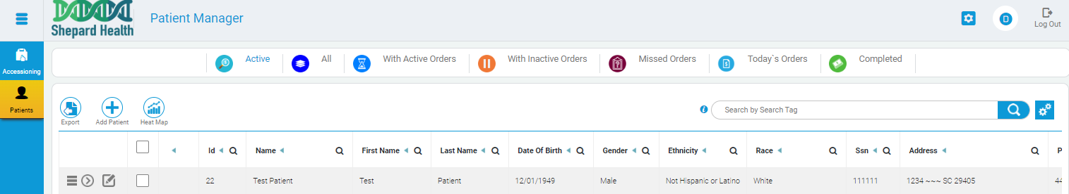
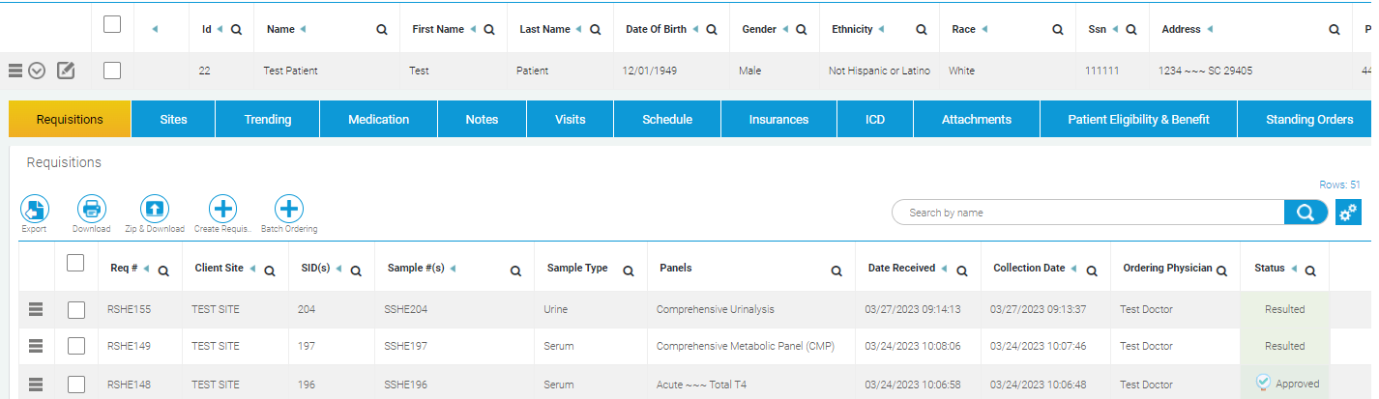
The Patient Manager Tab
The second tab available on the client portal it the Patients tab, highlighted in yellow.
In this screen clients can;
Add and Delete Patients
Edit Patients
View Patient Details
View Current and Historical Results
Upload patient documents
Create an Order/Requisition (including standing orders)
View patient results over time and trending

Slide 10
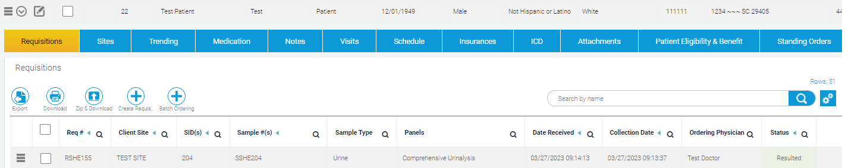
Pressing the “Details” button will drop down more information and options for the selected patient.
The default filter after selecting details will be requisitions, which will show all patient’s result(s) with the most recent order or in process requisition listed on top.
There will also be other options available listed above as various tabs. The currently selected one will be highlighted in yellow.

Slide 11
All patient demographics are easily managed from the details window.
There are multiple features that allow for;
ICD codes storage in association to the patient for easy future ordering.
Trending function will show results over time.
Add and delete site information, which can allow for multiple locations the ability to search for the patient in their system.
Visit information and Clinical Notes.
Patient scheduling for labwork

Slide 12

THANK YOU!
Thank you for choosing to be a Shepard Health Partner
For more information or for any additional help and guidance, please reach out to the lab.
(770) 558-3393
Support@shepardhealthlab.com
We look forward to our continued partnership and your support as we grow and develop.

